Slide 1
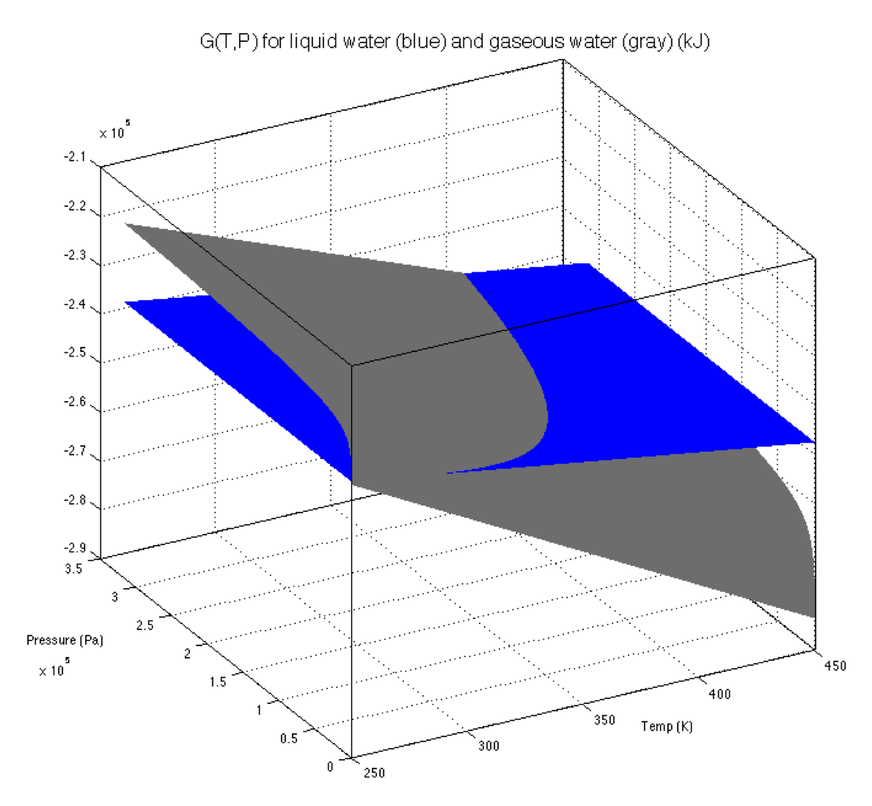
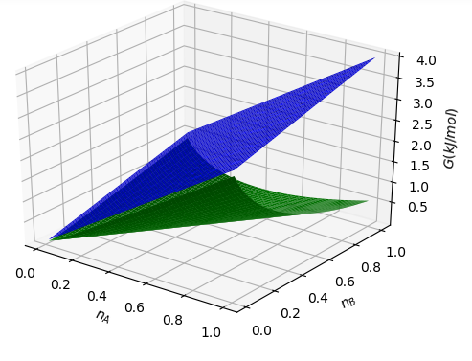
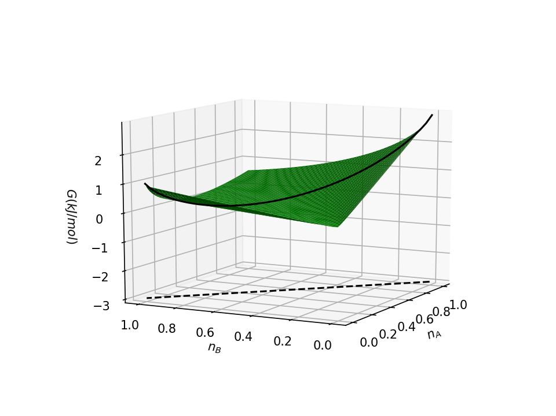
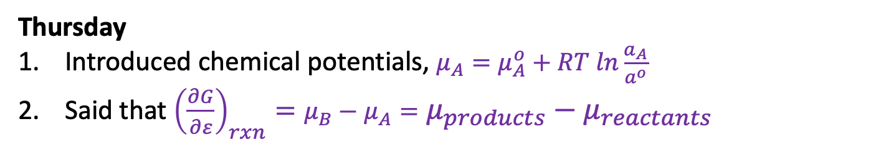
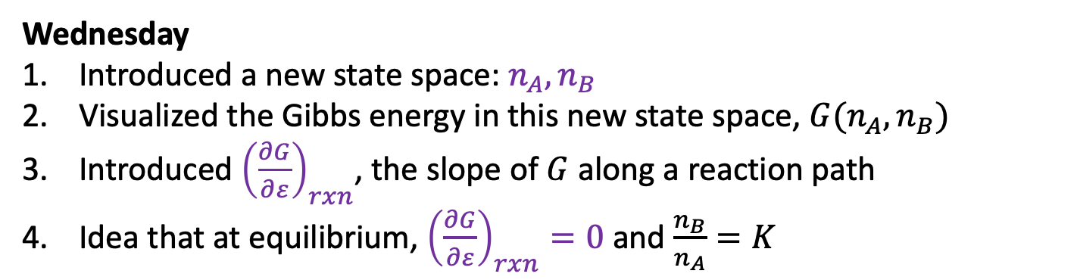


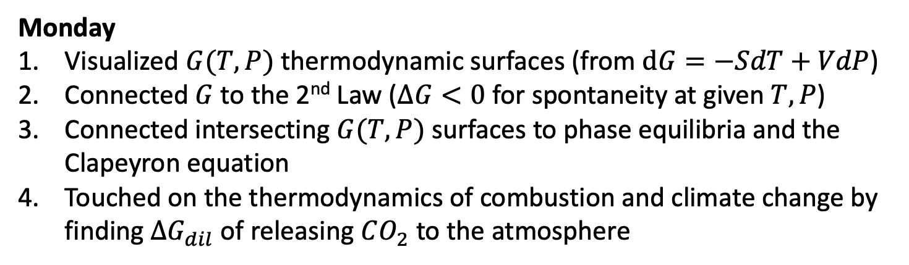





Recap of the week
Monday
Visualized $G(T,P)$ thermodynamic surfaces (from $dG=−SdT+VdP$)
Connected $G$to the 2nd Law ($∆G<0$ for spontaneity at given $T,P$)
Connected intersecting $G(T,P)$ surfaces to phase equilibria and the Clapeyron equation
Touched on the thermodynamics of combustion and climate change by finding $∆G_{dil}$ of releasing $CO_{2}$ to the atmosphere
$$G^{o}$$
Wednesday
Introduced a new state space: $n_{A},n_{B}$
Visualized the Gibbs energy in this new state space, $G(n_{A},n_{B})$
Introduced ${\left(\frac{∂G}{∂ε}\right)}_{rxn}$, the slope of $G$ along a reaction path
Idea that at equilibrium, ${\left(\frac{∂G}{∂ε}\right)}_{rxn}=0$ and $\frac{n_{B}}{n_{A}}=K$
$$G(n_{A},n_{B})$$
$$∆G_{mix}$$
$$G$$
$${\left(\frac{∂G}{∂ε}\right)}_{rxn}$$
Thursday
Introduced chemical potentials, $μ_{A}=μ_{A}^{o}+RT ln\frac{a_{A}}{a^{o}}$
Said that ${\left(\frac{∂G}{∂ε}\right)}_{rxn}=μ_{B}−μ_{A}=μ_{products}−μ_{reactants}$
$$G(n_{A},n_{B})$$
$$ε$$

Slide 2
Today
Derivation of the Clapeyron equation
Wrap up the connection between ${\left(\frac{∂G}{∂ε}\right)}_{rxn}$, $Q$, and $K$

Slide 3
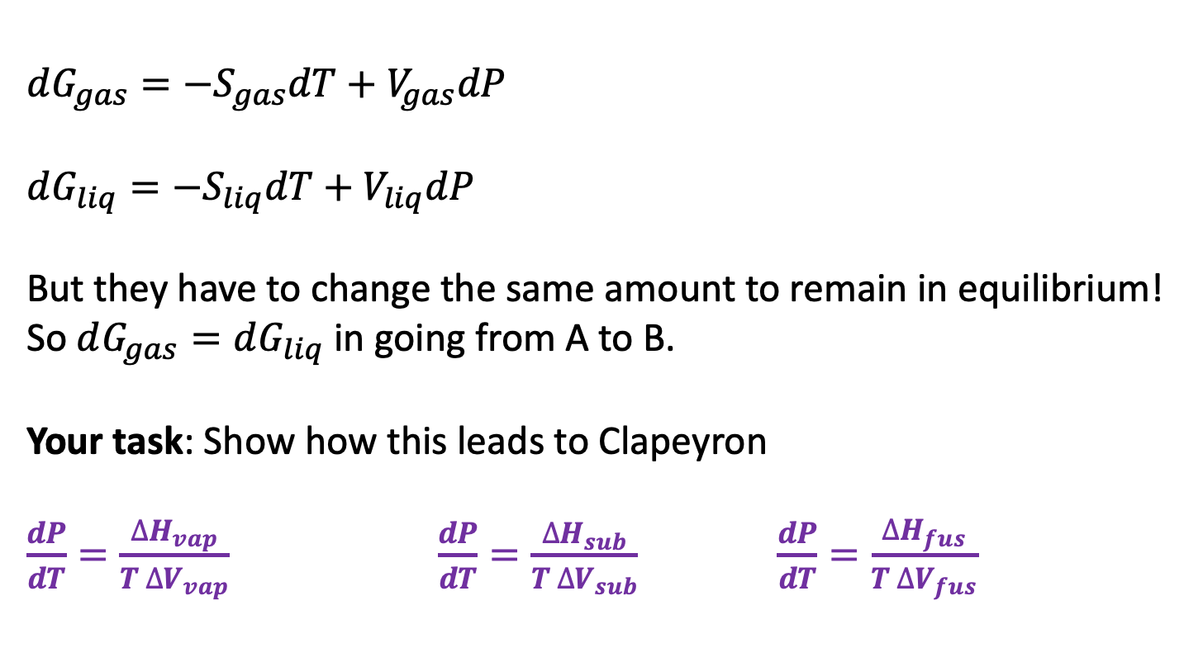
Derivation of the Clapeyron equation
$dG_{gas}=−S_{gas}dT+V_{gas}dP$
$dG_{liq}=−S_{liq}dT+V_{liq}dP$
But they have to change the same amount to remain in equilibrium! So $dG_{gas}=dG_{liq}$ in going from A to B.
Your task: Show how this leads to Clapeyron
$\frac{dP}{dT}=\frac{∆H_{vap}}{T ∆V_{vap}}$ $\frac{dP}{dT}=\frac{∆H_{sub}}{T ∆V_{sub}}$ $\frac{dP}{dT}=\frac{∆H_{fus}}{T ∆V_{fus}}$
B
A

Slide 4

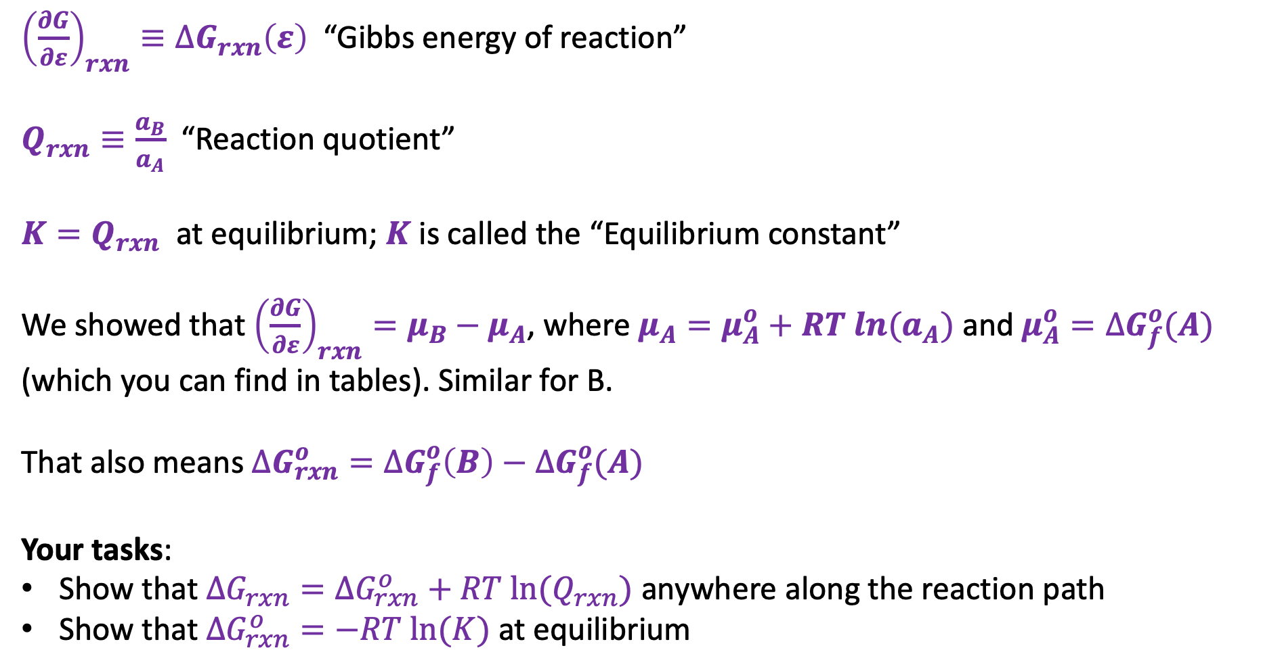
2a. Connection between ${\left(\frac{∂G}{∂ε}\right)}_{rxn}$, $∆G_{rxn}\left(ε\right)$, $Q$, and $K$ for the reaction A->B
${\left(\frac{∂G}{∂ε}\right)}_{rxn}≡∆G_{rxn}\left(ε\right)$ “Gibbs energy of reaction”
$Q_{rxn}≡\frac{a_{B}}{a_{A}}$ “Reaction quotient”
${K=Q}_{rxn}$ at equilibrium; $K$ is called the “Equilibrium constant”
We showed that ${\left(\frac{∂G}{∂ε}\right)}_{rxn}=μ_{B}−μ_{A}$, where $μ_{A}=μ_{A}^{o}+RT ln{(a}_{A})$ and $μ_{A}^{o}=∆G_{f}^{o}(A)$ (which you can find in tables). Similar for B.
That also means $∆G_{rxn}^{o}=∆G_{f}^{o}\left(B\right)−∆G_{f}^{o}(A)$
Your tasks:
Show that $∆G_{rxn}=∆G_{rxn}^{o}+RT ln⁡(Q_{rxn})$ anywhere along the reaction path
Show that $∆G_{rxn}^{o}=−RT ln⁡(K)$ at equilibrium
$$ε$$

Slide 5
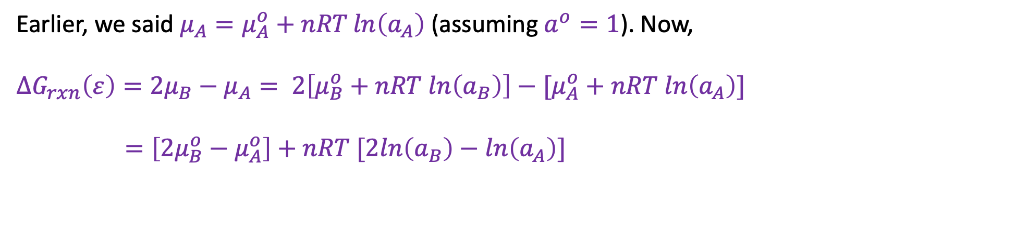
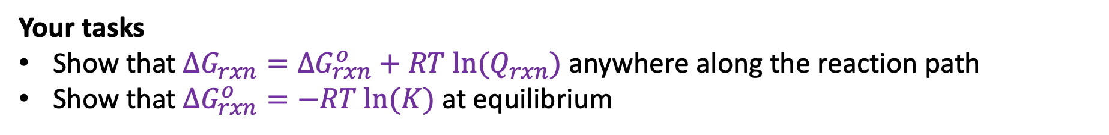
2b. Connection between ${\left(\frac{∂G}{∂ε}\right)}_{rxn}$, $∆G_{rxn}\left(ε\right)$, $Q$, and $K$ for the reaction A->B
What if the reaction path were $A→2B$?
Earlier, we said $μ_{A}=μ_{A}^{o}+nRT\ln\left(a_{A}\right)$ (assuming $a^{o}=1$). Now,
$$∆G_{rxn}\left(ε\right)={2μ}_{B}−μ_{A}= 2\left[μ_{B}^{o}+nRT ln\left(a_{B}\right)\right]−[μ_{A}^{o}+nRT ln\left(a_{A}\right)]$$
$$=\left[2μ_{B}^{o}−μ_{A}^{o}\right]+nRT [2ln\left(a_{B}\right)−ln\left(a_{A}\right)]$$
Your tasks
Show that $∆G_{rxn}=∆G_{rxn}^{o}+RT ln⁡(Q_{rxn})$ anywhere along the reaction path
Show that $∆G_{rxn}^{o}=−RT ln⁡(K)$ at equilibrium

